Slide 1
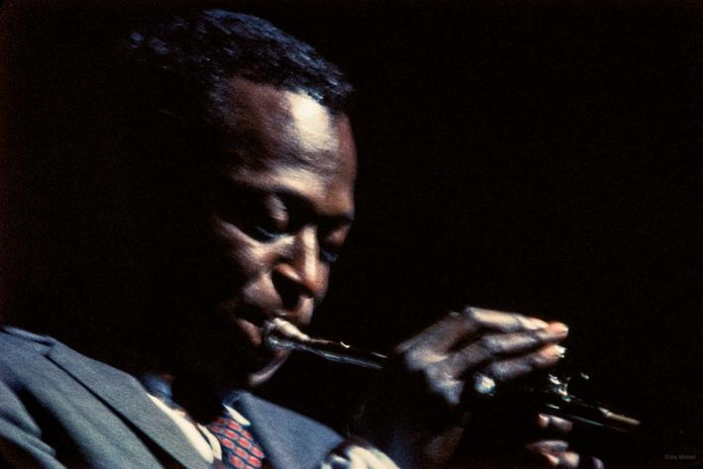
PROGETTO “DATAJAZZ”
Schembri Matteo Jacopo
1000012121

Slide 2
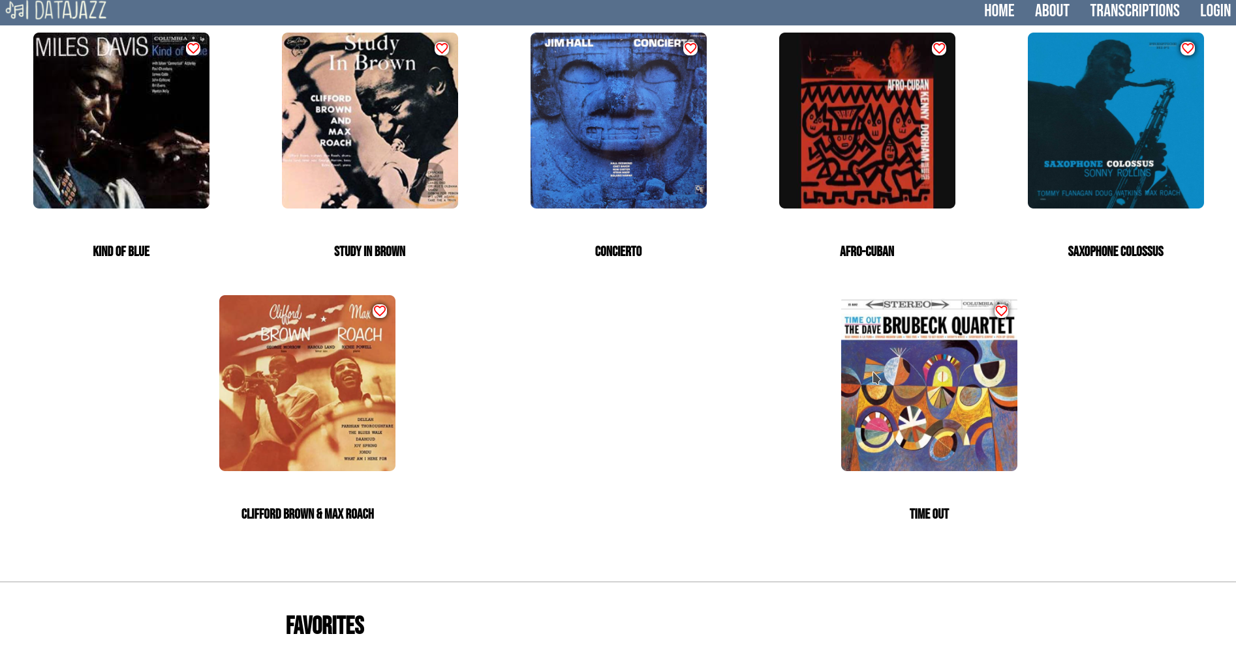

Slide 3
CARICAMENTO CONTENUTI
HTML
<div class="choice__grid-album" id="grid-album"> </div>
JAVASCRIPT
let grid = document.querySelector("#grid-album");
album.forEach((element, index) => {
element.titolo;
element.immagine;
element.descrizione;
let albumBox = document.createElement("div");
albumBox.className = 'albumBoxClass';
albumBox.id = 'albumBoxID-' + index;
let image = document.createElement("img");
image.id = 'img' + index;
image.addEventListener("click", function(){
show_description(index)
})
image.src = ("./img/" + element.immagine);
albumBox.appendChild(image);
let title = document.createElement("h1");
title.textContent = element.titolo;
albumBox.appendChild(title);
let favoriteButton = document.createElement("i");
favoriteButton.className = "material-icons";
favoriteButton.innerHTML = "&#xe87e;";
favoriteButton.addEventListener("click", function() {
add_favorite(element)
})
albumBox.appendChild(favoriteButton);
let description = document.createElement("p");
description.className = 'descriptionClass';
description.id = "descrizione" + index;
description.textContent = element.descrizione;
albumBox.appendChild(description);

Slide 4
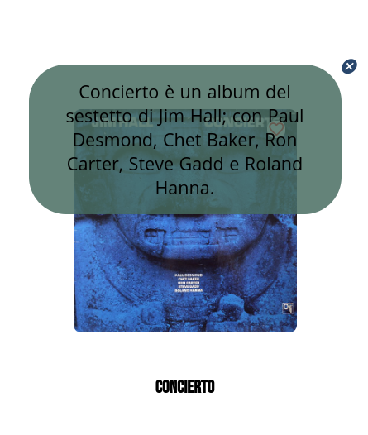
DESCRIZIONE
let closeDesc = document.createElement("i");
closeDesc.className = "material-icons-canc";
closeDesc.innerHTML = "&#xe5c9;";
closeDesc.addEventListener("click", function(){
show_description(index)
})
description.appendChild(closeDesc);
grid.appendChild(albumBox);
});
JAVASCRIPT
function show_description(id){
let x = document.getElementById("descrizione" + id);
if (x.style.display === "none"){
x.style.display = "block";
}else{
x.style.display = "none";
}
}

Slide 5
.descriptionClass{
color: black;
font-size: 1.5em;
text-align: center;
display: none;
font-family: 'Open Sans', sans-serif;
word-spacing: 1px;
position: absolute;
background-color: #466b5ed5;
border-radius: 50px;
z-index: 2;
box-sizing: border-box;
padding: 20px;
}
.material-icons {
font-family: 'Material Icons';
font-size: 24px;
color: red;
cursor:pointer;
box-shadow: 0 0 10px #000000;
border-radius: 10px;
position: absolute;
top: 75px;
right: 75px;
background-color: white;
}
CSS
.material-icons-canc {
font-family: 'Material Icons';
color: #28466B;
cursor:pointer;
border-radius: 10px;
position: absolute;
top: -10px;
right: -20px;
}
.material-icons:hover {
background-color: #28466b5e;
}
.fa-heart-broken:hover {
background-color: #28466b5e;
}
.choice__grid-album{
display: flex;
align-items: center;
justify-content: space-around;
flex-direction: row;
flex-wrap: wrap;
}
.albumBoxClass {
position:relative;
display: flex;
flex-direction: column;
}
.choice__grid-album img{
height: 300px;
width: 300px;
margin: 60px;
border-radius: 10px;
cursor: pointer;
position: relative;
}

Slide 6
BARRA DI RICERCA
HTML
<div id="ricerca">
<div id="container">
<input type="text" id="searchbar" placeholder="Search..." >
</div>
</div>
JAVASCRIPT
document.querySelector("#searchbar").addEventListener("keyup", search);
function search(){
let input = document.getElementById("searchbar");
let filter = input.value.toUpperCase();
let gridS = document.getElementById("grid-album");
let albumsearch = gridS.getElementsByClassName("albumBoxClass");
for (let index = 0; index < albumsearch.length; index++) {
let h1 = albumsearch[index].getElementsByTagName("h1")[0];
let result = h1.innerText;
if (result.toUpperCase().indexOf(filter) > -1) {
albumsearch[index].style.display = "";
} else {
albumsearch[index].style.display = "none";
}
}
}

Slide 7
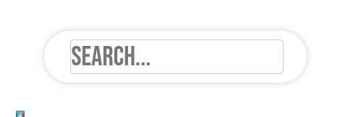
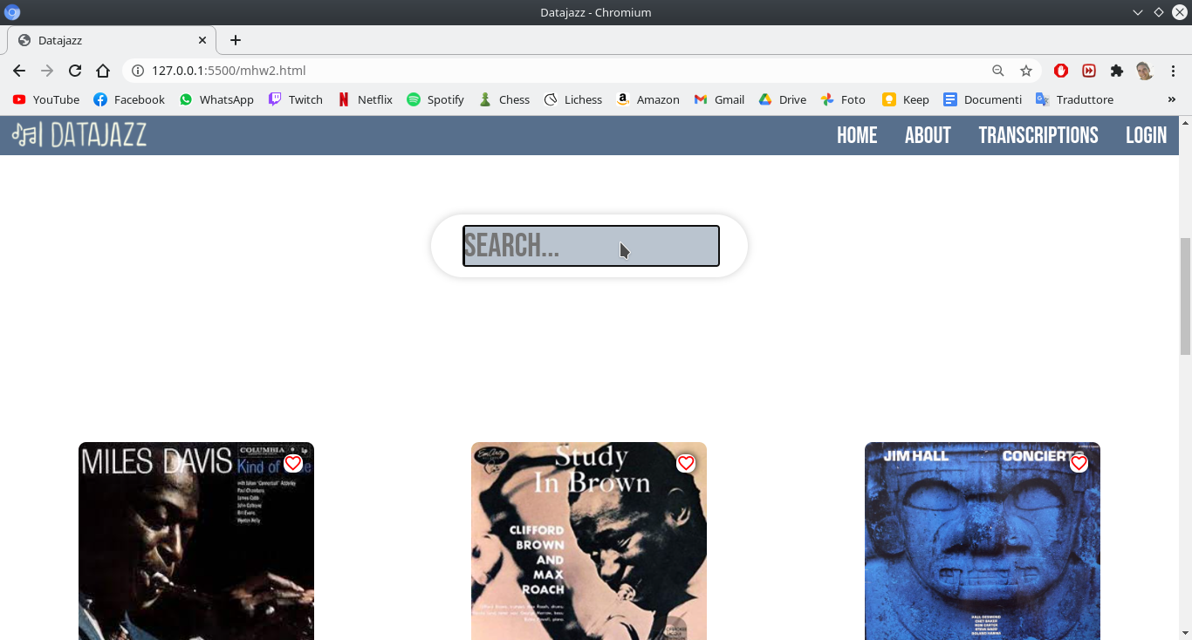
CSS
#ins {
font-size: 50px;
line-height: 50px;
color: #aaa;
flex-basis: 80%;
width: 100%;
}
input[type=text] {
width: 90%;
display: flex;
border: 2px solid #ccc;
border-radius: 6px;
font-size: 42px;
}
input[type=text]:focus {
transition: all 0.7s ease;
background-color: #28466b52;
}
#ricerca {
margin: 150px 0 150px 0;
}
#container {
height: 80px;
box-sizing: border-box;
box-shadow: 0 0 10px #cecece;
max-width: 640px;
background: white;
justify-content: flex-start;
display: flex;
padding-left: 40px;
align-items: center;
line-height: 24px;
border-radius: 100px;
flex-basis: 100%;
}

Slide 8
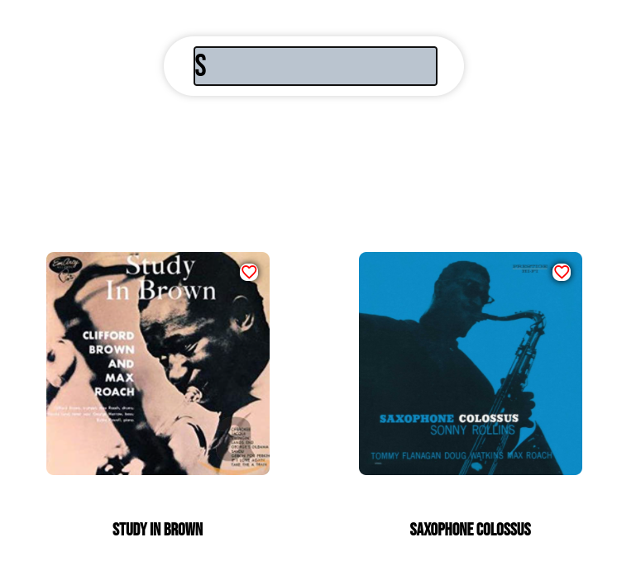
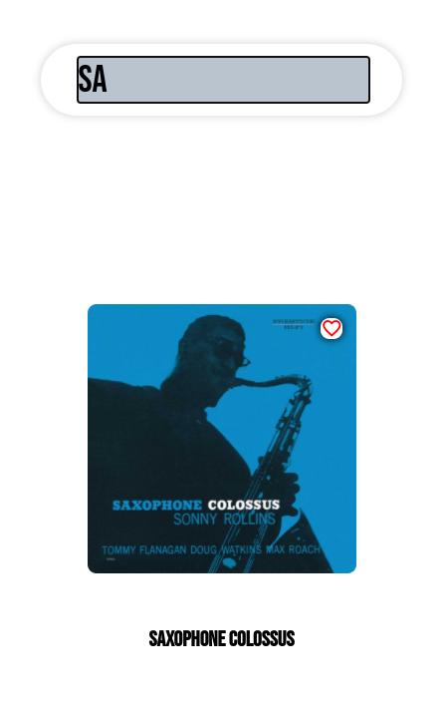

Slide 9
PREFERITI
let albumBox = document.createElement("div");
albumBox.classList.add(['favorites__grid-album','favorite']);
albumBox.id = 'albumBoxID-' + index;
let image = document.createElement("img");
image.id = 'img' + index;
image.src = ("./img/" + element.immagine);
albumBox.appendChild(image);
let removeFavoriteButton = document.createElement("i");
removeFavoriteButton.className ="fas fa-heart-broken";
removeFavoriteButton.addEventListener("click", function()
{
remove_favorite(index);
})
albumBox.appendChild(removeFavoriteButton);
let title = document.createElement("h1");
title.textContent = element.titolo;
albumBox.appendChild(title);
grid.appendChild(albumBox);
});
}
HTML
<div id="favorites" class="favorites">
<h1 id=fav>Favorites</h1>
<div class="favorites__grid">
</div>
</div>
JAVASCRIPT
var favorites = [ ];
function updateFavorites(){
let grid = document.getElementById('favorites').querySelector('.favorites__grid');
grid.innerHTML = '';
favorites.forEach( (element, index) => {
element.titolo;
element.immagine;

Slide 10
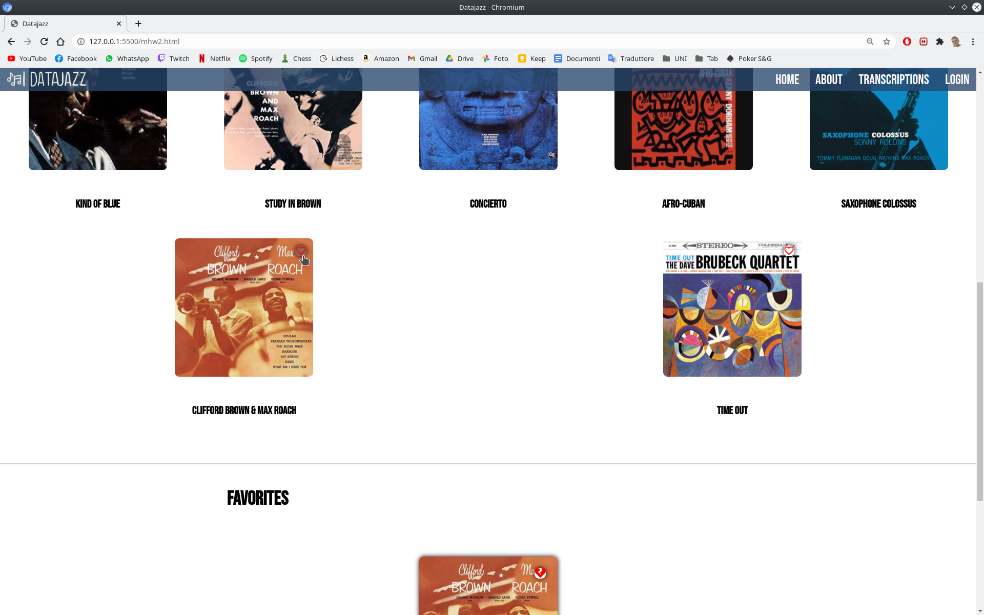
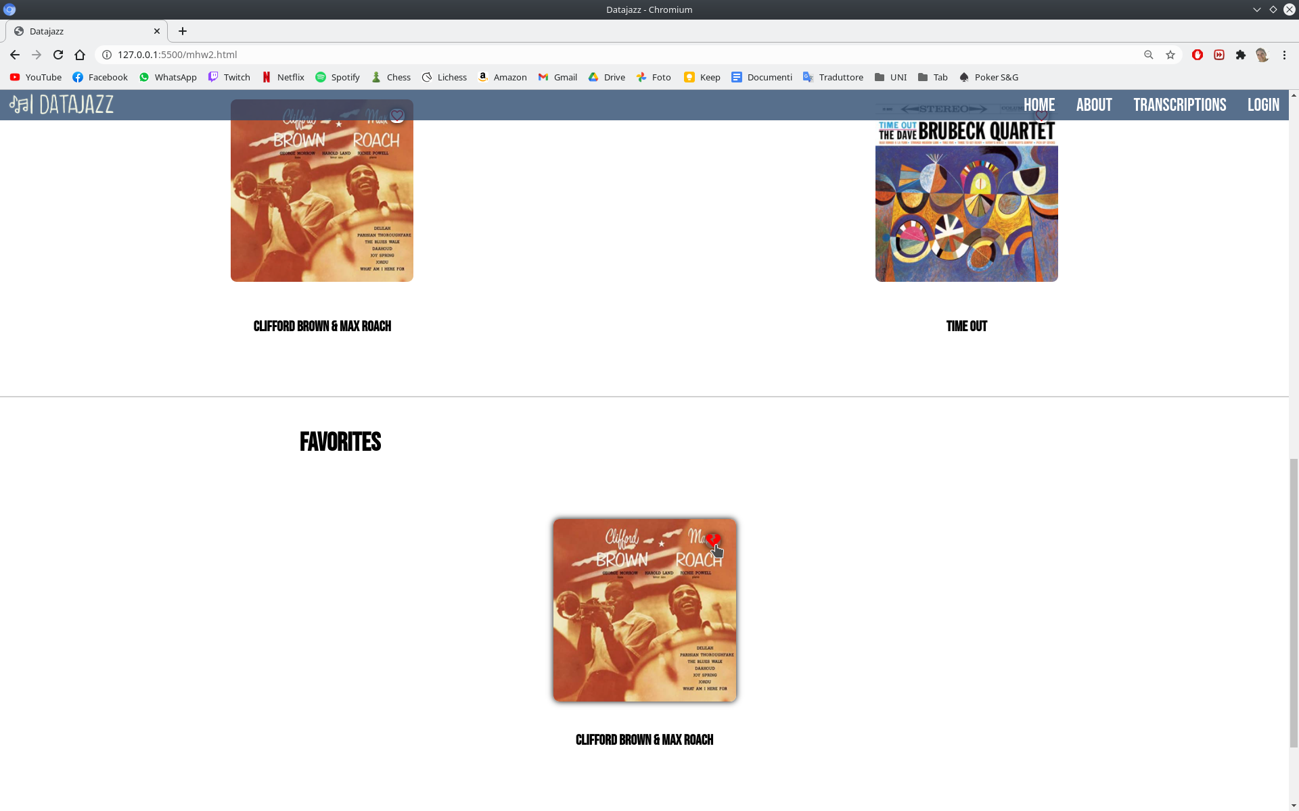
function add_favorite(element){
if (!favorites.includes(element)){
favorites.push(element)
}
updateFavorites()
}
function remove_favorite(index) {
favorites.splice(index, 1);
updateFavorites();
}

Slide 11
CSS
#fav {
margin-top: 50px;
font-size: 42px;
padding-right: 1000px;
}
.favorites__grid{
margin-top: 50px;
display: flex;
flex-wrap: wrap;
align-items: center;
justify-content: space-around;
flex-direction: row;
}
.albumBoxFavorite {
display: flex;
align-items: center;
flex-direction: column;
margin: 0px 50px 50px 50px;
position: relative;
}
.albumBoxFavorite img{
height: 300px;
width: 300px;
box-shadow: 0 0 10px #000000;
border-radius: 10px;
margin: 50px ;
}
.fa-heart-broken {
color: red;
font-size: 24px;
cursor:pointer;
box-shadow: 0 0 10px #000000;
border-radius: 10px;
position: absolute;
top: 75px;
right: 75px;
background-color: white;
}

Slide 12
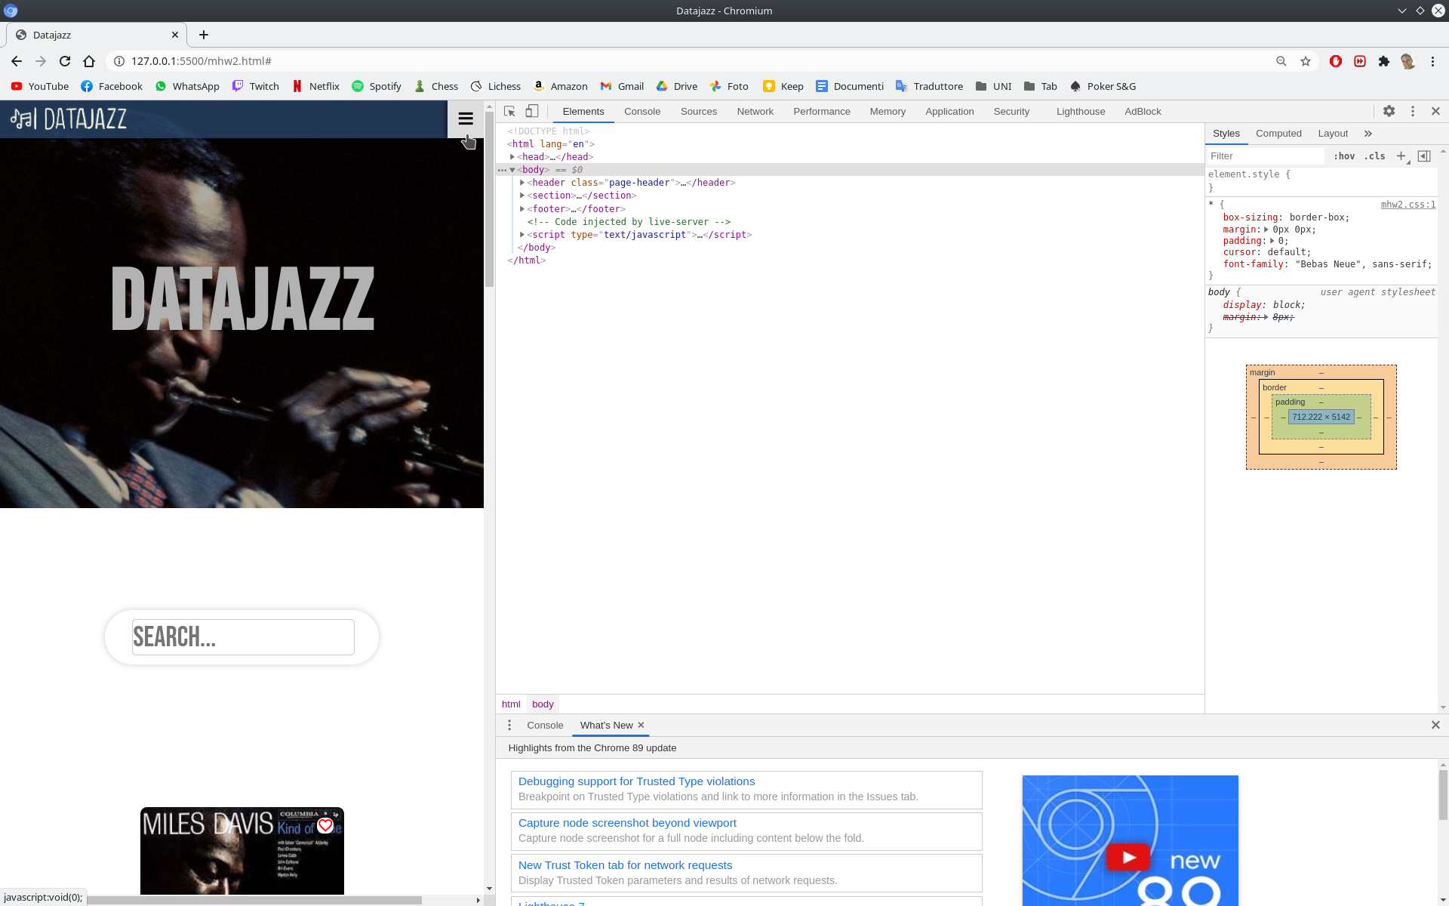
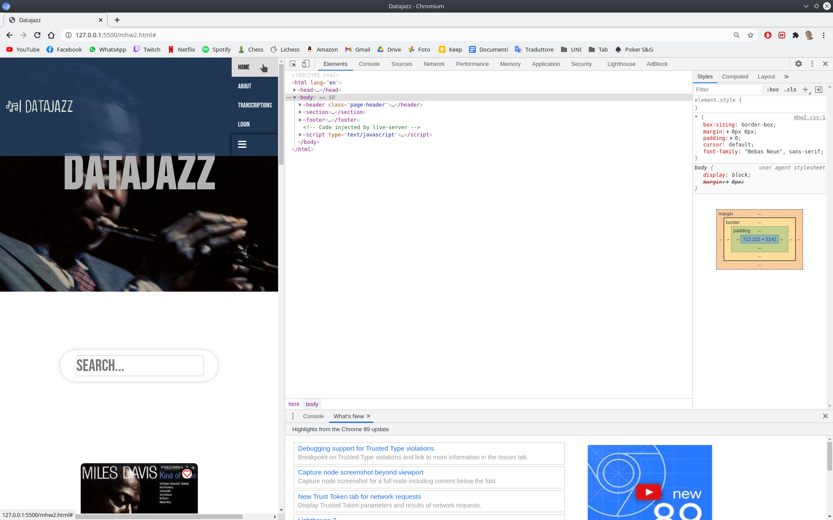
MENU NAVBAR MOBILE
function showMenu() {
let x = document.getElementById("mobile__links");
if (x.style.display === "block") {
x.style.display = "none";
} else {
x.style.display = "block";
}
}

Slide 13
CSS
.nav-link {
display: none;
}
.mobile__nav {
display: block;
}
#mobile__links {
display: none;
}
.mobile__nav a {
color: white;
padding: 14px 16px;
text-decoration: none;
font-size: 17px;
display: block;
}
.mobile__nav a.icon__nav {
display: block;
font-size: 24px;
cursor:pointer;
box-shadow: 0 0 10px #000000;
}
.mobile__nav a:hover {
background-color: #ddd;
color: black;
}
.active {
background-color: #ffffff;
color: white;
}

